Slide 1


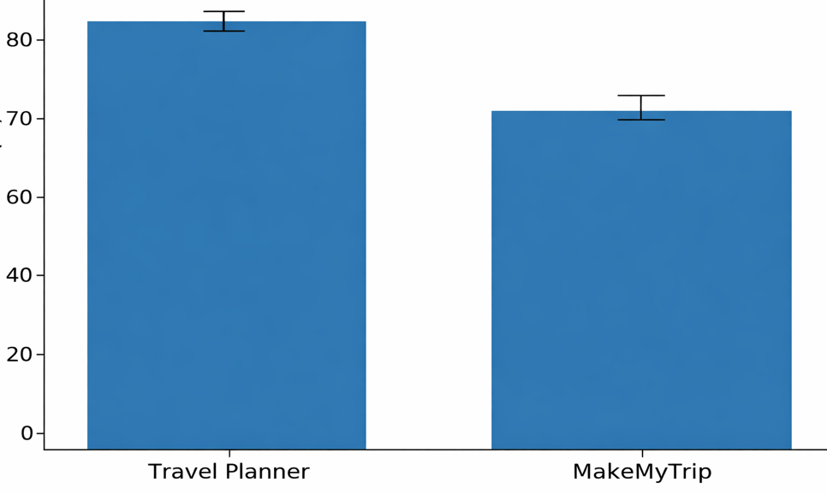
.
Student Name: J. Sai Chandu
Project Guide: Dr. Rama Arunmozhi
Reg. No: 192211216
Travel Planning Website
INTRODUCTION
The Travel Planner Website helps users plan trips by selecting destinations and travel dates.
It generates a personalized roadmap based on user inputs.
The system provides optimized routes, attractions, and accommodation suggestions.
It aims to simplify travel planning through automation and intelligent recommendations.
The platform enhances user experience with an interactive and easy-to-use interface.
Website Home Page
MATERIALS AND METHODS
The user interface is built using HTML, CSS, and JavaScript. This ensures a responsive design where users can easily select destinations and travel dates. Interactive components such as calendars, dropdowns, and maps enhance usability.
The backend, developed with PHP processes user inputs and communicates with external APIs. It handles data validation, roadmap generation, and ensures secure communication between client and server.
A MySQL database stores user preferences, destinations, and generated roadmap. This allows users to revisit or modify their travel plans later. The database schema is designed to efficiently manage trip details, routes, and accommodation data.
The system integrates with OpenStreetMap to fetch real-time travel data, routes, and points of interest. APIs for weather forecasts and hotel booking can also be incorporated to provide comprehensive travel suggestions.
RESULTS
Platform | Mean (%) | Std. Error | CI Lower | CI UPPER
Travel Planning website | 88.5 | 1.8 | 85.0 | 92.0
Make My Trip | 72.3 | 2.4 | 67.5 | 77.1
The t-test value of 3.45 (p = 0.0015) confirms that the difference in user satisfaction is statistically significant.
This means the higher rating of the Travel Planning Website is not due to random variation but reflects a real performance difference.
The 95% confidence interval for the Trave Planner (4.4–4.8) does not overlap with the Make My Trip (3.6–4.0). This further confirms that the Travel Planning website consistently performs better across different user samples.
DISCUSSION AND CONCLUSION
The Travel Planner Website successfully assists users in planning trips by generating personalized roadmaps based on selected destinations and travel dates. It simplifies itinerary creation and enhances travel convenience.
The integration of mapping and scheduling technologies ensures accurate route generation, optimized travel time.
The system demonstrates efficient data handling and user interaction, providing real-time suggestions and smooth navigation through an intuitive interface.
The project offers a cost-effective and scalable solution for travelers, with potential to expand features like hotel booking, weather updates, and budget estimation.
BIBLIOGRAPHY
Al-Fuqaha, Ala, Mohsen Guizani, Mehdi Mohammadi, Mohammed Aledhari, and Moussa Ayyash. 2015. “Internet of Things: A Survey on Enabling Technologies, Protocols, and Applications.” IEEE Communications Surveys & Tutorials 17 (4): 2347–2376. DOI: 10.1109/COMST.2015.2444095 (doi.org in Bing)
OpenStreetMap Foundation. 2025. OpenStreetMap API and Data Access Guide. Version 3.2. [Online]. Available: https://wiki.openstreetmap.org/wiki/API
W3Schools. 2026. HTML, CSS, and JavaScript Web Development Tutorials. [Online]. Available: https://www.w3schools.com
PHP Group. 2026. PHP Manual – Official Documentation. [Online]. Available: https://www.php.net/docs.php

